Slide 1

Evaluation Metrics
Notes:
Instructor Name

Slide 2
Please, type in the chat…
What kind of algorithms/models you know so far?

Slide 3
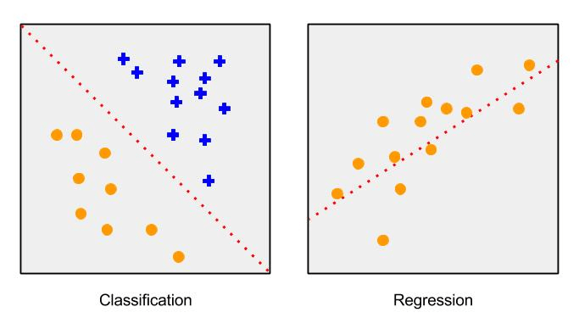
Supervised Learning
Two types of tasks:
Classification: When the label is a specific class
Determining if mail is spam or not spam
Determining if a picture has a cat or not

Slide 4
Supervised Learning
Two types of tasks:
Classification: When the label is a specific class
Determining if mail is spam or not spam
Determining if a picture has a cat or not
Regression: When the label is a real number
Predicting tomorrow’s temperature
Predicting the cost of coffee in 2023

Slide 5
Supervised Learning
Two types of tasks:
Classification: When the label is a specific class
Determining if mail is spam or not spam
Determining if a picture has a cat or not
Regression: When the label is a real number
Predicting tomorrow’s temperature
Predicting the cost of coffee in 2020
Classification labels are discrete
Small number of possible values
Regression labels are continuous

Slide 6
EVALUATION

Slide 7
How can we tell how good our system is?

Slide 8
Accuracy!
One way is to look at the accuracy of a model

Slide 9


Accuracy!
One way is to look at the accuracy of a model
Let’s say we have medical data of 100 people and our model detects whether these patients have cancer.
If our model correctly classifies 95 of these 100 patients, then we say our model has a 95% accuracy

Slide 10
Example
Imagine there’s a system that can quickly classify brain tumour/no brain tumour based on an MRI image.
Is there tumour?
yes
no
Recommend a patient to visit a doctor for confirmation and treatment
Do not recommend a patient to visit a doctor, tell them they’re healthy

Slide 11
Scenario #1
You receive a message from the system that says that you’re sick.
Having your knowledge about ML, would you trust it knowing about 95% accuracy?
Is there tumour?
yes
no
Recommend a patient to visit a doctor for confirmation and treatment
Do not recommend a patient to visit a doctor
Notes:
yes

Slide 12
Scenario #2
Actual | Predicted
healthy | sick
healthy | sick
healthy | sick
healthy | sick
healthy | sick
Now, imagine that for those 5% inaccurately classified by the system, people were actually healthy, but classified as sick?
You had this test, and you were classified as ‘sick’. Now, you need to visit a doctor.
Classified as sick
95%
5%
You actually have tumour, and you will start treatment on time
You’re actually healthy, no need to worry!

Slide 13
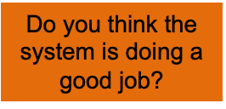
Scenario #2
Actual | Predicted
healthy | sick
healthy | sick
healthy | sick
healthy | sick
healthy | sick
Now, imagine that for those 5% inaccurately classified by the system, people were actually healthy, but classified as sick?
You had this test, and you were classified as ‘sick’. Now, you need to visit a doctor.
Classified as sick
95%
5%
You actually have tumour, and you will start treatment on time
You’re actually healthy, no need to worry!

Slide 14
Scenario #3
Actual | Predicted
sick | healthy
sick | healthy
sick | healthy
sick | healthy
sick | healthy
Now, imagine that for those 5% inaccurately classified by the system, people were actually sick, but classified as healthy?
You had this test, and you were classified as healthy. No need to visit a doctor.
Classified as healthy
95%
5%
You’re healthy, no need to worry!
You actually have brain tumour. You didn’t visit a doctor and didn’t start the treatment on time.

Slide 15
Scenario #3
Actual | Predicted
sick | healthy
sick | healthy
sick | healthy
sick | healthy
sick | healthy
Now, imagine that for those 5% inaccurately classified by the system, people were actually sick, but classified as healthy?
You had this test, and you were classified as healthy. No need to visit a doctor.
Classified as healthy
95%
5%
You’re healthy, no need to worry!
You actually have brain tumour. You didn’t visit a doctor and didn’t start the treatment on time.

Slide 16
Scenario #4
Now, imagine that out of the 5 people:
2 people were actually healthy, but classified as sick
3 people were sick, but classified as healthy
Actual | Predicted
healthy | sick
sick | healthy
healthy | sick
sick | healthy
sick | healthy

Slide 17
Scenario #4
Now, imagine that out of the 5 people:
2 people were actually healthy, but classified as sick
3 people were sick, but classified as healthy
Would you trust this system?
Actual | Predicted
healthy | sick
sick | healthy
healthy | sick
sick | healthy
sick | healthy

Slide 18
Other Metrics for Evaluation
Now, imagine that out of the 5 people:
2 people were actually healthy, but classified as sick
3 people were sick, but classified as healthy
Turns out that accuracy doesn’t show us the whole picture
What if we want to know how many times the system classifies sick people as healthy?
Actual | Predicted
healthy | sick
sick | healthy
healthy | sick
sick | healthy
sick | healthy

Slide 19
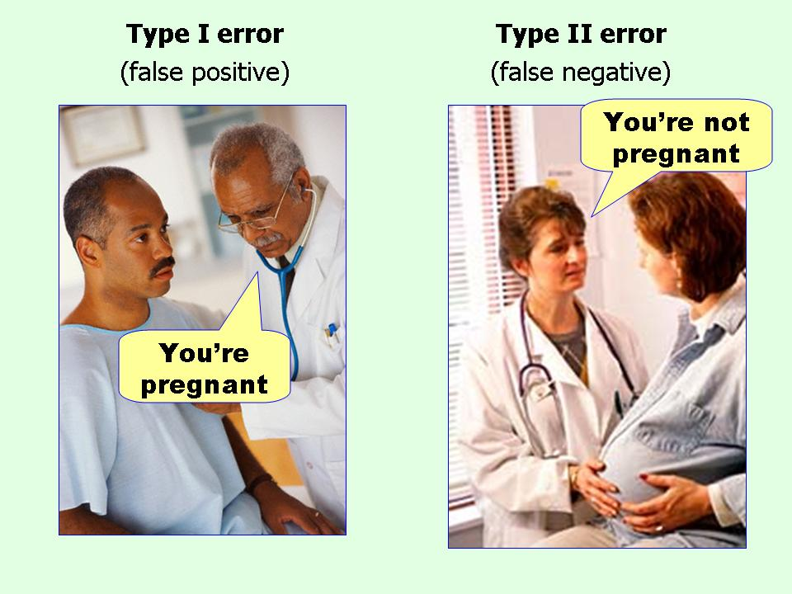
What’s the difference between

Slide 20

Another example
Take the example of detecting whether there is a fire in your home or not
False Positive (FP): When you think there is a fire, but there isn’t
False Negative (FN): When you think there is no fire, but there is
Are these errors equally bad?

Slide 21
Other Metrics for Evaluation
 | Actual: Yes | Actual: No
Predicted: Yes | True Positive (TP) | False Positive (FP)
Predicted: No | False Negative (FN) | True Negative (TN)

Slide 22
Other Metrics for Evaluation
 | Actual: Yes | Actual: No
Predicted: Yes | True Positive (TP) | False Positive (FP)
Predicted: No | False Negative (FN) | True Negative (TN)
This table, when filled in with actual numbers, is called a confusion matrix

Slide 23
Evaluation Example
Actual Predicted TP/FP/TN/FN?
Fire Fire
No Fire No Fire
Fire Fire
No Fire Fire
Fire Fire
No Fire Fire
Fire No Fire
No Fire Fire
No Fire No Fire
No Fire No Fire

Slide 24
Evaluation Example
Actual Predicted TP/FP/TN/FN?
Fire Fire TP
No Fire No Fire TN
Fire Fire TP
No Fire Fire FP
Fire Fire TP
No Fire Fire FP
Fire No Fire FN
No Fire Fire FP
No Fire No Fire TN
No Fire No Fire TN

Slide 25
Evaluation Example
Actual Predicted TP/FP/TN/FN?
Fire Fire TP
No Fire No Fire TN
Fire Fire TP
No Fire Fire FP
Fire Fire TP
No Fire Fire FP
Fire No Fire FN
No Fire Fire FP
No Fire No Fire TN
No Fire No Fire TN
TP: ? | FP: ?
FN: ? | TN: ?

Slide 26
Evaluation Example
Actual Predicted TP/FP/TN/FN?
Fire Fire TP
No Fire No Fire TN
Fire Fire TP
No Fire Fire FP
Fire Fire TP
No Fire Fire FP
Fire No Fire FN
No Fire Fire FP
No Fire No Fire TN
No Fire No Fire TN
TP: 3 | FP: 3
FN: 1 | TN: 3

Slide 27
Evaluation Example
Actual Predicted TP/FP/TN/FN?
Fire Fire TP
No Fire No Fire TN
Fire Fire TP
No Fire Fire FP
Fire Fire TP
No Fire Fire FP
Fire No Fire FN
No Fire Fire FP
No Fire No Fire TN
No Fire No Fire TN
TP: 3 | FP: 3
FN: 1 | TN: 3
Accuracy?

Slide 28
Evaluation Example
Actual Predicted TP/FP/TN/FN?
Fire Fire TP
No Fire No Fire TN
Fire Fire TP
No Fire Fire FP
Fire Fire TP
No Fire Fire FP
Fire No Fire FN
No Fire Fire FP
No Fire No Fire TN
No Fire No Fire TN
TP: 3 | FP:3
FN: 1 | TN: 3
Accuracy?
6/10 or 60%

Slide 29
Other Metrics for Evaluation
Precision: Probability that a positive prediction is correct, TP / (TP + FP)
Recall (or Sensitivity): Probability that an actual positive outcome is predicted correctly, TP / (TP + FN)
Specificity: Probability that an actual negative outcome is predicted correctly, TN / (TN + FP)
F1 Score: Combination of precision and recall,
(2 * Precision * Recall) / (Precision + Recall)

Slide 30
Evaluation Example
Accuracy? 6/10 or 60%
Precision: TP / (TP + FP) = ?
Recall: TP / (TP + FN) = ?
Specificity: TN / (TN + FP) = ?
F1 Score: (2 * P * R) / (P + R) = ?
TP: 3 | FP: 3
FN: 1 | TN: 3

Slide 31
Evaluation Example
Accuracy? 6/10 or 60%
Precision: TP / (TP + FP) = 3/6 = 50%
Recall: TP / (TP + FN) = 3/4 = 75%
Specificity: TN / (TN + FP) = 3/6 = 50%
F1 Score: (2 * P * R) / (P + R) = 60%
TP: 3 | FP: 3
FN: 1 | TN: 3

Slide 32
How to apply it?
Step 1
Preparing and cleaning data:
Drop unnecessary columns
Fill up null values
Replace values

Slide 33
How to apply it?
Step 1
Step 2
Preparing and cleaning data:
Drop unnecessary columns
Fill up null values
Replace values
Dividing data into train & test sets, and X & Y labels:
train = train.drop(['Y'], axis = 1)
test = test.drop(['Y’'], axis = 1)
train_test_split

Slide 34
How to apply it?
Step 1
Step 2
Step 3
Preparing and cleaning data:
Drop unnecessary columns
Fill up null values
Replace values
Dividing data into train & test sets, and X & Y labels
Applying a ML algorithm.
For example, Decision trees:
decisiontree = DecisionTreeClassifier()
decisiontree.fit(x_train, y_train)
y_pred = decisiontree.predict(x_val)

Slide 35
How to apply it?
Step 1
Step 2
Step 3
Step 4
Preparing and cleaning data:
Drop unnecessary columns
Fill up null values
Replace values
Dividing data into train & test sets, and X & Y labels
Applying a ML algorithm.
For example, Decision trees
Evaluating model:
Confusion matrix
Accuracy
Recall
Precision
Specificity
F1 score

Slide 36


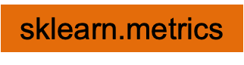
Step 4 in details: libraries
from sklearn.metrics import confusion_matrix
from sklearn.metrics import plot_confusion_matrix
from sklearn.metrics import accuracy_score
from sklearn.metrics import recall_score
from sklearn.metrics import precision_score
from sklearn.metrics import f1_score

Slide 37
Step 4 in details: syntax
function | syntax | output
confusion matrix | confusion_matrix(actual label, predicted label) | array
plotting confusion matrix | plot_confusion_matrix(model variable, x_test values, y test values) | Image plot
accuracy, recall, precision, f1 score | function_name(actual label, predicted label) | Float number (between 0 and 1)

Slide 38
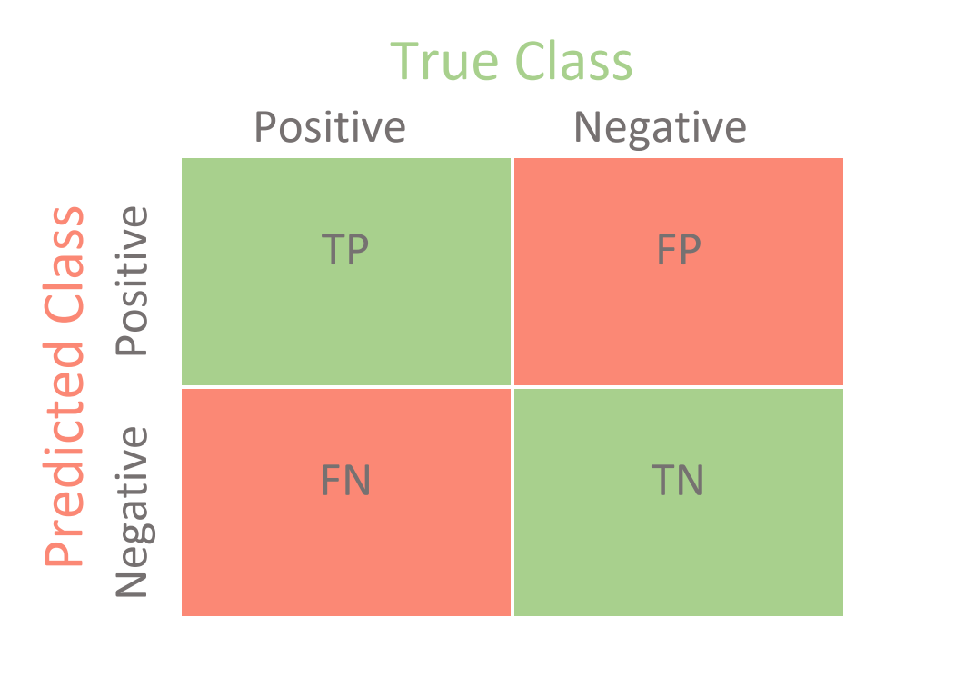
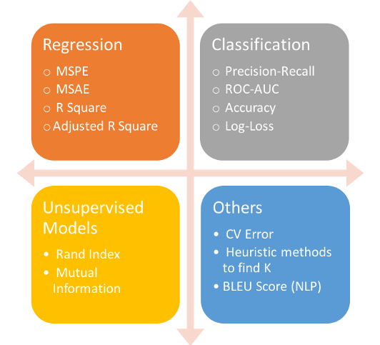
Summary
Confusion matrix - table that allows visualization of the performance of an algorithm
Accuracy - What percent of all of your predictions were correct?
Precision — What is the accuracy of positive predictions?
Recall — What percent of the positive cases did you catch?
F1 score — What percent of positive predictions were correct?

Slide 39
What about other types of algorithms?
Of course, there are other evaluation metrics outside classification
Silhouette score (K means clustering)
Mean Squared Error (Regression)
LogLoss (probabilities)
Gini Coefficient (Classification )
Read more here if interested.

Slide 40
Code along
Today, no copying from an instructor’s screen, but rather work in groups and write code on your own! Your tasks are:
Fill in some missing values (mostly discussed in previous code alongs)
Print confusion matrix and other metrics (recall, precision, specificity, f1 score)
Answer practice questions (1-2)

Slide 41
What if it’s a multiclass classification?
 | High (Actual) | Medium (Actual) | Low (Actual)
High (pred) | 10 | 4 | 1
Medium (pred) | 6 | 15 | 2
Low (pred) | 3 | 0 | 5
Imagine that there’s a system that classifies temperature into high, medium, and low

Slide 42
What if it’s a multiclass classification?
 | High (Actual) | Medium (Actual) | Low (Actual)
High (pred) | 10 | 4 | 1
Medium (pred) | 6 | 15 | 2
Low (pred) | 3 | 0 | 5
Accuracies:
Acc(High) = 10 / 10 + 4 + 1 = 33.3%
Precision: TP / (TP + FP)
Recall: TP / (TP + FN)
Specificity: TN / (TN + FP)

Slide 43
What if it’s a multiclass classification?
 | High (Actual) | Medium (Actual) | Low (Actual)
High (pred) | 10 | 4 | 1
Medium (pred) | 6 | 15 | 2
Low (pred) | 3 | 0 | 5
Accuracies:
Acc(High) = 10 / 10 + 4 + 1 = 33.3%
Acc(Medium) = 6 / 6 + 15 + 2 = 26.1%
Precision: TP / (TP + FP)
Recall: TP / (TP + FN)
Specificity: TN / (TN + FP)

Slide 44
What if it’s a multiclass classification?
 | High (Actual) | Medium (Actual) | Low (Actual)
High (pred) | 10 | 4 | 1
Medium (pred) | 6 | 15 | 2
Low (pred) | 3 | 0 | 5
Accuracies:
Acc(High) = 10 / 10 + 4 + 1 = 33.3%
Acc(Medium) = 6 / 6 + 15 + 2 = 26.1%
Acc(Low) = 3 / 3 + 0 + 5 = 37.5%
Precision: TP / (TP + FP)
Recall: TP / (TP + FN)
Specificity: TN / (TN + FP)

Slide 45
What if it’s a multiclass classification?
TP means that ‘Actual’ = ‘predicted’
 | High (Actual) | Medium (Actual) | Low (Actual)
High (pred) | 10 | 4 | 1
Medium (pred) | 6 | 15 | 2
Low (pred) | 3 | 0 | 5
TP (High) = 10
TP (Medium) = 15
TP (Low) = 5
Precision: TP / (TP + FP)
Recall: TP / (TP + FN)
Specificity: TN / (TN + FP)

Slide 46
What if it’s a multiclass classification?
TP means that ‘Actual’ = ‘predicted’
 | High (Actual) | Medium (Actual) | Low (Actual)
High (pred) | 10 | 4 | 1
Medium (pred) | 6 | 15 | 2
Low (pred) | 3 | 0 | 5
TP (High) = 10
TP (Medium) = 15
TP (Low) = 5
FP means that ‘Actual’ = no, but ‘predicted’ = yes
FP (High) = 4 + 1 = 5
FP (Medium) = 6 + 2 = 8
FP (Low) = 3 + 0 = 3
Precision: TP / (TP + FP)
Recall: TP / (TP + FN)
Specificity: TN / (TN + FP)

Slide 47
What if it’s a multiclass classification?
TP means that ‘Actual’ = ‘predicted’
 | High (Actual) | Medium (Actual) | Low (Actual)
High (pred) | 10 | 4 | 1
Medium (pred) | 6 | 15 | 2
Low (pred) | 3 | 0 | 5
TP (High) = 10
TP (Medium) = 15
TP (Low) = 5
FP means that ‘Actual’ = no, but ‘predicted’ = yes
FP (High) = 4 + 1 = 5
FP (Medium) = 6 + 2 = 8
FP (Low) = 3 + 0 = 3
So, Precision values are as following:
Precision: TP / (TP + FP)
Recall: TP / (TP + FN)
Specificity: TN / (TN + FP)
P (High) = 10 / 10 + 5 = 66.6%
P (Medium) = 15 / 15 + 8 = 65.2%
P (Low) = 5 / 5 + 3 = 62.5%

Slide 48
What if it’s a multiclass classification?
TP means that ‘Actual’ = ‘predicted’
 | High (Actual) | Medium (Actual) | Low (Actual)
High (pred) | 10 | 4 | 1
Medium (pred) | 6 | 15 | 2
Low (pred) | 3 | 0 | 5
TP (High) = 10
TP (Medium) = 15
TP (Low) = 5
FN means that ‘Actual’ = yes, but ‘predicted’ = no
FN (High) = 6 + 3 = 9
FN (Medium) = 4 + 0 = 4
FN (Low) = 2 + 1 = 3
Precision: TP / (TP + FP)
Recall: TP / (TP + FN)
Specificity: TN / (TN + FP)

Slide 49
What if it’s a multiclass classification?
TP means that ‘Actual’ = ‘predicted’
 | High (Actual) | Medium (Actual) | Low (Actual)
High (pred) | 10 | 4 | 1
Medium (pred) | 6 | 15 | 2
Low (pred) | 3 | 0 | 5
TP (High) = 10
TP (Medium) = 15
TP (Low) = 5
FN means that ‘Actual’ = yes, but ‘predicted’ = no
FN (High) = 6 + 3 = 9
FN (Medium) = 4 + 0 = 4
FN (Low) = 2 + 1 = 3
So, Recall values are as following:
Precision: TP / (TP + FP)
Recall: TP / (TP + FN)
Specificity: TN / (TN + FP)
R (High) = 10 / 10 + 9 = 52.6%
R (Medium) = 15 / 15 + 4= 78.9%
R (Low) = 5 / 5 + 3 = 62.5%

Slide 50
What if it’s a multiclass classification?
TN means that ‘Actual’ = no, ‘predicted’ = no
 | High (Actual) | Medium (Actual) | Low (Actual)
High (pred) | 10 | 4 | 1
Medium (pred) | 6 | 15 | 2
Low (pred) | 3 | 0 | 5
TN (High) = 15 + 2 + 5 + 0 = 22
Precision: TP / (TP + FP)
Recall: TP / (TP + FN)
Specificity: TN / (TN + FP)

Slide 51
What if it’s a multiclass classification?
TN means that ‘Actual’ = no, ‘predicted’ = no
 | High (Actual) | Medium (Actual) | Low (Actual)
High (pred) | 10 | 4 | 1
Medium (pred) | 6 | 15 | 2
Low (pred) | 3 | 0 | 5
TN (High) = 15 + 2 + 5 + 0 = 22
TN (Medium) = 10 + 1 + 3 + 5 = 19
Precision: TP / (TP + FP)
Recall: TP / (TP + FN)
Specificity: TN / (TN + FP)

Slide 52
What if it’s a multiclass classification?
TN means that ‘Actual’ = no, ‘predicted’ = no
 | High (Actual) | Medium (Actual) | Low (Actual)
High (pred) | 10 | 4 | 1
Medium (pred) | 6 | 15 | 2
Low (pred) | 3 | 0 | 5
TN (High) = 15 + 2 + 5 + 0 = 22
TN (Medium) = 10 + 1 + 3 + 5 = 19
TN (Low) = 10 + 4 + 6 + 15 = 35
Precision: TP / (TP + FP)
Recall: TP / (TP + FN)
Specificity: TN / (TN + FP)

Slide 53
What if it’s a multiclass classification?
TN means that ‘Actual’ = no, ‘predicted’ = no
 | High (Actual) | Medium (Actual) | Low (Actual)
High (pred) | 10 | 4 | 1
Medium (pred) | 6 | 15 | 2
Low (pred) | 3 | 0 | 5
TN (High) = 15 + 2 + 5 + 0 = 22
TN (Medium) = 10 + 1 + 3 + 5 = 19
TN (Low) = 10 + 4 + 6 + 15 = 35
FP means that ‘Actual’ = no, but ‘predicted’ = yes
FP (High) = 4 + 1 = 5
FP (Medium) = 6 + 2 = 8
FP (Low) = 3 + 0 = 3
Precision: TP / (TP + FP)
Recall: TP / (TP + FN)
Specificity: TN / (TN + FP)

Slide 54
What if it’s a multiclass classification?
TN means that ‘Actual’ = no, ‘predicted’ = no
 | High (Actual) | Medium (Actual) | Low (Actual)
High (pred) | 10 | 4 | 1
Medium (pred) | 6 | 15 | 2
Low (pred) | 3 | 0 | 5
TN (High) = 15 + 2 + 5 + 0 = 22
TN (Medium) = 10 + 1 + 3 + 5 = 19
TN (Low) = 10 + 4 + 6 + 15 = 35
FP means that ‘Actual’ = no, but ‘predicted’ = yes
FP (High) = 4 + 1 = 5
FP (Medium) = 6 + 2 = 8
FP (Low) = 3 + 0 = 3
So, Specificity values are as following:
Precision: TP / (TP + FP)
Recall: TP / (TP + FN)
Specificity: TN / (TN + FP)
S (High) = 22 / 22 + 5 = 81.5%
S (Medium) = 19 / 19 + 8= 67.8%
S (Low) = 35 / 35 + 3 = 92.1%

Slide 55
What if it’s a multiclass classification?
P (High) = 66.6%
P (Medium) = 65.2%
P (Low) = 62.5%
 | High (Actual) | Medium (Actual) | Low (Actual)
High (pred) | 10 | 4 | 1
Medium (pred) | 6 | 15 | 2
Low (pred) | 3 | 0 | 5
Precision:
R (High) = 52.6%
R (Medium) = 78.9%
R (Low) = 62.5%
Recall:
S (High) = 81.5%
S (Medium) = 67.8%
S (Low) = 92.1%
Specificity:
Precision: TP / (TP + FP)
Recall: TP / (TP + FN)
Specificity: TN / (TN + FP)
F1 Score: (2 * P * R) / (P + R)
F1 (High) = (2 * 66.6 * 52.6) / (66.6 + 52.6) = 58.7%
F1 (Medium) = (2 * 65.2 * 78.9) / (65.2 + 78.9) = 71.4%
F1 (Low) = (2 * 62.5 * 62.5) / (62.5 + 62.5) = 62.5%

Slide 56
If you want to know more about multiclass classification
Read this article.

